Slide 1
Artificial Intelligence – An Introduction

Slide 2
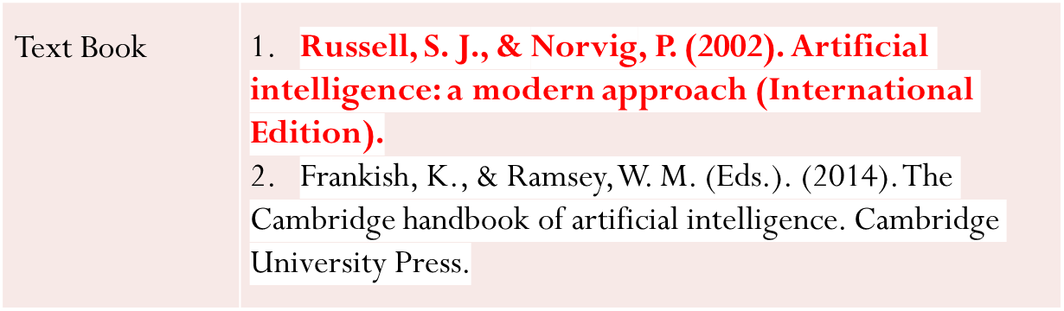
Text Book and Teaching methods
Teaching Methods | Lecture, CT, Presentation, Assignment, Mid exam, Final exam.

Slide 3
Course Objectives
The course is designed to provide the background of the following topics:
1. Knowledge of what constitutes "Artificial" Intelligence and how to identify systems with Artificial Intelligence.
2. Explain how Artificial Intelligence enables capabilities that are beyond conventional technology, for example, chess- playing computers, self-driving cars, robotic vacuum cleaners.
3. Implement classical Artificial Intelligence techniques, such as search algorithms, minimax algorithm, neural networks, tracking, and robot localization.
4. Ability to apply Artificial Intelligence techniques for problem solving.
5. Explain the limitations of current Artificial Intelligence techniques.

Slide 4
Course Learning Outcomes
At the end of this course:
Knowledge and understanding
You should have a knowledge and understanding of the basic concepts of Artificial Intelligence including Search, Game Playing, KBS (including Uncertainty), Planning and Machine Learning.
Intellectual skills
You should be able to use this knowledge and understanding of appropriate principles and guidelines to synthesise solutions to tasks in AI and to critically evaluate alternatives.
Practical skills
You should be able to use a well known declarative language (Prolog) and to construct simple AI systems.
Transferable Skills
You should be able to solve problems and evaluate outcomes and alternatives

Slide 5
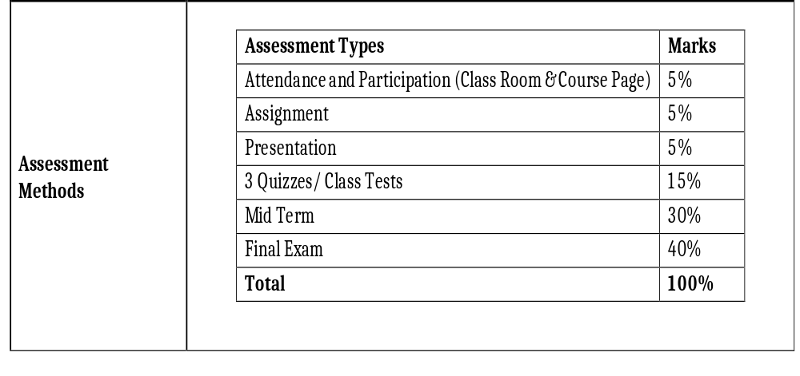
Assessment Method

Slide 6
Areas of AI and Some Dependencies
Knowledge Representation
Search
Logic
Machine Learning
Planning
Expert Systems
NLP
Vision
Robotics

Slide 7
What is Artificial Intelligence ?
making computers that think?
the automation of activities we associate with human thinking, like decision making, learning ... ?
the art of creating machines that perform functions that require intelligence when performed by people ?
the study of mental faculties through the use of computational models ?

Slide 8
What is Artificial Intelligence ?
the study of computations that make it possible to perceive, reason and act ?
a field of study that seeks to explain and emulate intelligent behaviour in terms of computational processes ?
a branch of computer science that is concerned with the automation of intelligent behaviour ?
anything in Computing Science that we don't yet know how to do properly ? (!)

Slide 9
What is AI?
There is no single definition, but several approaches, that Russell-Norvig summarize in four main ones.
These approaches follow different points of view.
Their influences are diverse (Philosophy, Mathematics, Psychology, Biology...).
Their fields of application are ample and interrelated.

Slide 10
Approaches to AI
Systems that act like humans
  The study of how to obtain that computers perform tasks at which, at the moment, people are better (Rich and Knight, 1991)
Systems that think like humans
  The effort to make computers think... machines with minds in the full and literal sense (Haugeland, 1985)
Systems that think rationally
  The study of the mental faculties through the study of computational models (Charniak and McDermott, 1985)
Systems that act rationally
  The effort to explain and emulate the intelligent behavior in terms of computational processes (Shalkoff, 1990)

Slide 11
What is Artificial Intelligence ?
THOUGHT
Systems that think
like humans
Systems that think
rationally
Systems that act
like humans
Systems that act
rationally
BEHAVIOUR
HUMAN
RATIONAL

Slide 12
Systems that act like humans:
Turing Test
“The art of creating machines that perform functions that require intelligence when performed by people.” (Kurzweil)
“The study of how to make computers do things at which, at the moment, people are better.” (Rich and Knight)
The Turing test, developed by Alan Turing in 1950, is a test of a machine's ability to exhibit intelligent behavior equivalent to, or indistinguishable from, that of a human. Turing proposed that a human evaluator would judge natural language conversations between a human and a machine designed to generate human-like responses.

Slide 13

Systems that act like humans
?
You enter a room which has a computer terminal. You have a fixed period of time to type what you want into the terminal, and study the replies. At the other end of the line is either a human being or a computer system.
If it is a computer system, and at the end of the period you cannot reliably determine whether it is a system or a human, then the system is deemed to be intelligent.

Slide 14
Systems that act like humans
The Turing Test approach
  a human questioner cannot tell if
    there is a computer or a human answering his question, via teletype (remote communication)
  The computer must behave intelligently
Intelligent behavior
  to achieve human-level performance in all cognitive tasks

Slide 15
Systems that act like humans
These cognitive tasks include:
  Natural language processing
    for communication with human
  Knowledge representation
    to store information effectively & efficiently
  Automated reasoning
    to retrieve & answer questions using the stored information
  Machine learning
    to adapt to new circumstances

Slide 16
The total Turing Test
Includes two more issues:
  Computer vision
    to perceive objects (seeing)
  Robotics
    to move objects (acting)

Slide 17
What is Artificial Intelligence ?
THOUGHT
Systems that think
like humans
Systems that think
rationally
Systems that act
like humans
Systems that act
rationally
BEHAVIOUR
HUMAN
RATIONAL

Slide 18
Systems that think like humans: cognitive modeling
Humans as observed from ‘inside’
How do we know how humans think?
  Introspection vs. psychological experiments
Cognitive Science
“The exciting new effort to make computers think … machines with minds in the full and literal sense” (Haugeland)
“[The automation of] activities that we associate with human thinking, activities such as decision-making, problem solving, learning …” (Bellman)

Slide 19
What is Artificial Intelligence ?
THOUGHT
Systems that think
like humans
Systems that think
rationally
Systems that act
like humans
Systems that act
rationally
BEHAVIOUR
HUMAN
RATIONAL

Slide 20
Systems that think ‘rationally’
"laws of thought"
Humans are not always ‘rational’
Rational - defined in terms of logic?
Logic can’t express everything (e.g. uncertainty)
Logical approach is often not feasible in terms of computation time (needs ‘guidance’)
“The study of mental facilities through the use of computational models” (Charniak and McDermott)
“The study of the computations that make it possible to perceive, reason, and act” (Winston)

Slide 21
What is Artificial Intelligence ?
THOUGHT
Systems that think
like humans
Systems that think
rationally
Systems that act
like humans
Systems that act
rationally
BEHAVIOUR
HUMAN
RATIONAL

Slide 22
Systems that act rationally:
“Rational agent”
Rational behavior: doing the right thing
The right thing: that which is expected to maximize goal achievement, given the available information
Giving answers to questions is ‘acting’.
I don't care whether a system:
  replicates human thought processes
  makes the same decisions as humans
  uses purely logical reasoning

Slide 23
Systems that act rationally
Logic → only part of a rational agent, not all of rationality
  Sometimes logic cannot reason a correct conclusion
  At that time, some specific (in domain) human knowledge or information is used
Thus, it covers more generally different situations of problems
  Compensate the incorrectly reasoned conclusion

Slide 24
Systems that act rationally
Study AI as rational agent –
2 advantages:
  It is more general than using logic only
    Because: LOGIC + Domain knowledge
  It allows extension of the approach with more scientific methodologies

Slide 25
Rational agents
An agent is an entity that perceives and acts
This course is about designing rational agents
Abstractly, an agent is a function from percept histories to actions:
[f: P* → A]
For any given class of environments and tasks, we seek the agent (or class of agents) with the best performance
Caveat: computational limitations make perfect rationality unachievable
  → design best program for given machine resources

Slide 26
Artificial
  Produced by human art or effort, rather than originating naturally.
Intelligence
is the ability to acquire knowledge and use it" [Pigford and Baur]
So AI was defined as:
  AI is the study of ideas that enable computers to be intelligent.
  AI is the part of computer science concerned with design of computer systems that exhibit human intelligence(From the Concise Oxford Dictionary)

Slide 27
From the above two definitions, we can see that AI has two major roles:
  Study the intelligent part concerned with humans.
  Represent those actions using computers.

Slide 28
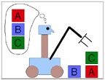
Goals of AI
To make computers more useful by letting them take over dangerous or tedious tasks from human
Understand principles of human intelligence

Slide 29
The Foundation of AI
Philosophy
  At that time, the study of human intelligence began with no formal expression
  Initiate the idea of mind as a machine and its internal operations

Slide 30
The Foundation of AI
Mathematics formalizes the three main area of AI: computation, logic, and probability
  Computation leads to analysis of the problems that can be computed
    complexity theory
  Probability contributes the “degree of belief” to handle uncertainty in AI
  Decision theory combines probability theory and utility theory (bias)

Slide 31
The Foundation of AI
Psychology
  How do humans think and act?
  The study of human reasoning and acting
  Provides reasoning models for AI
  Strengthen the ideas
    humans and other animals can be considered as information processing machines

Slide 32
The Foundation of AI
Computer Engineering
  How to build an efficient computer?
  Provides the artifact that makes AI application possible
  The power of computer makes computation of large and difficult problems more easily
  AI has also contributed its own work to computer science, including: time-sharing, the linked list data type, OOP, etc.

Slide 33
The Foundation of AI
Control theory and Cybernetics
  How can artifacts operate under their own control?
  The artifacts adjust their actions
    To do better for the environment over time
    Based on an objective function and feedback from the environment
  Not limited only to linear systems but also other problems
    as language, vision, and planning, etc.

Slide 34
The Foundation of AI
Linguistics
  For understanding natural languages
    different approaches has been adopted from the linguistic work
  Formal languages
  Syntactic and semantic analysis
  Knowledge representation

Slide 35
The main topics in AI
Artificial intelligence can be considered under a number of headings:
  Search (includes Game Playing).
  Representing Knowledge and Reasoning with it.
  Planning.
  Learning.
  Natural language processing.
  Expert Systems.
  Interacting with the Environment
  (e.g. Vision, Speech recognition, Robotics)
We won’t have time in this course to consider all of these.

Slide 36
Some Advantages of Artificial Intelligence
  more powerful and more useful computers
  new and improved interfaces
  solving new problems
  better handling of information
  relieves information overload
  conversion of information into knowledge

Slide 37
The Disadvantages
  increased costs
  difficulty with software development - slow and expensive
  few experienced programmers
  few practical products have reached the market as yet.

Slide 38
Search
Search is the fundamental technique of AI.
  Possible answers, decisions or courses of action are structured into an abstract space, which we then search.
Search is either "blind" or “uninformed":
  blind
    we move through the space without worrying about what is coming next, but recognising the answer if we see it
  informed
    we guess what is ahead, and use that information to decide where to look next.
We may want to search for the first answer that satisfies our goal, or we may want to keep searching until we find the best answer.

Slide 39
Knowledge Representation & Reasoning
The second most important concept in AI
If we are going to act rationally in our environment, then we must have some way of describing that environment and drawing inferences from that representation.
  how do we describe what we know about the world ?
  how do we describe it concisely ?
  how do we describe it so that we can get hold of the right piece of knowledge when we need it ?
  how do we generate new pieces of knowledge ?
  how do we deal with uncertain knowledge ?

Slide 40
Knowledge
Declarative
Procedural
Declarative knowledge deals with factoid questions (what is the capital of India? Etc.)
Procedural knowledge deals with “How”
Procedural knowledge can be embedded in declarative knowledge

Slide 41
Planning
Given a set of goals, construct a sequence of actions that achieves those goals:
  often very large search space
  but most parts of the world are independent of most other parts
  often start with goals and connect them to actions
  no necessary connection between order of planning and order of execution
  what happens if the world changes as we execute the plan and/or our actions don’t produce the expected results?

Slide 42
Learning
If a system is going to act truly appropriately, then it must be able to change its actions in the light of experience:
  how do we generate new facts from old ?
  how do we generate new concepts ?
  how do we learn to distinguish different situations in new environments ?

Slide 43
Interacting with the Environment
In order to enable intelligent behaviour, we will have to interact with our environment.
Properly intelligent systems may be expected to:
  accept sensory input
    vision, sound, …
  interact with humans
    understand language, recognise speech,
    generate text, speech and graphics, …
  modify the environment
    robotics

Slide 44
History of AI
AI has a long history
  Ancient Greece
    Aristotle
  Historical Figures Contributed
    Ramon Lull
    Al Khowarazmi
    Leonardo da Vinci
    David Hume
    George Boole
    Charles Babbage
    John von Neuman
  As old as electronic computers themselves (c1940)

Slide 45

The ‘von Neuman’ Architecture

Slide 46
History of AI
Origins
  The Dartmouth conference: 1956
    John McCarthy (Stanford)
    Marvin Minsky (MIT)
    Herbert Simon (CMU)
    Allen Newell (CMU)
    Arthur Samuel (IBM)
The Turing Test (1950)
“Machines who Think”
  By Pamela McCorckindale

Slide 47
Periods in AI
Early period - 1950’s & 60’s
  Game playing
    brute force (calculate your way out)
  Theorem proving
    symbol manipulation
  Biological models
    neural nets
Symbolic application period - 70’s
  Early expert systems, use of knowledge
Commercial period - 80’s
  boom in knowledge/ rule bases

Slide 48
Periods in AI cont’d
? period - 90’s and New Millenium
Real-world applications, modelling, better evidence, use of theory, ......?
Topics: data mining, formal models, GA’s, fuzzy logic, agents, neural nets, autonomous systems
Applications
  visual recognition of traffic
  medical diagnosis
  directory enquiries
  power plant control
  automatic cars

Slide 49
Fashions in AI
Progress goes in stages, following funding booms and crises: Some examples:
1. Machine translation of languages
1950’s to 1966 - Syntactic translators
1966 - all US funding cancelled
1980 - commercial translators available
2. Neural Networks
1943 - first AI work by McCulloch & Pitts
1950’s & 60’s - Minsky’s book on “Perceptrons” stops nearly all work on nets
1986 - rediscovery of solutions leads to massive growth in neural nets research
The UK had its own funding freeze in 1973 when the Lighthill report reduced AI work severely -Lesson: Don’t claim too much for your discipline!!!!
Look for similar stop/go effects in fields like genetic algorithms and evolutionary computing. This is a very active modern area dating back to the work of Friedberg in 1958.

Slide 50
Symbolic and Sub-symbolic AI
Symbolic AI is concerned with describing and manipulating our knowledge of the world as explicit symbols, where these symbols have clear relationships to entities in the real world.
Sub-symbolic AI (e.g. neural-nets) is more concerned with obtaining the correct response to an input stimulus without ‘looking inside the box’ to see if parts of the mechanism can be associated with discrete real world objects.
This course is concerned with symbolic AI.

Slide 51
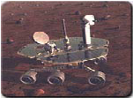
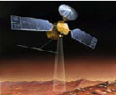
AI Applications
Autonomous Planning & Scheduling:
  Autonomous rovers.

Slide 52
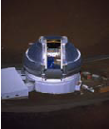
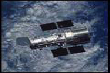
AI Applications
Autonomous Planning & Scheduling:
  Telescope scheduling

Slide 53


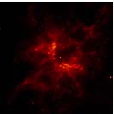
AI Applications
Autonomous Planning & Scheduling:
  Analysis of data:

Slide 54
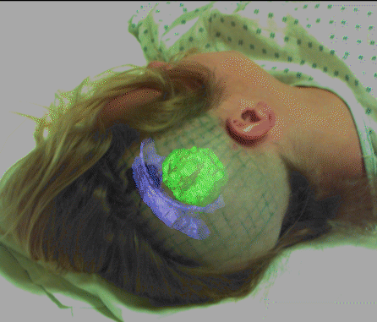

AI Applications
Medicine:
  Image guided surgery

Slide 55

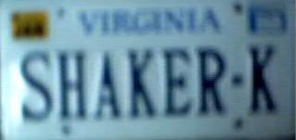


AI Applications
Medicine:
  Image analysis and enhancement

Slide 56

AI Applications
Transportation:
  Autonomous vehicle control:

Slide 57

AI Applications
Transportation:
  Pedestrian detection:

Slide 58
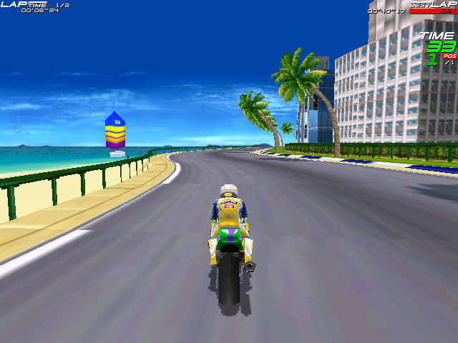
AI Applications
Games:

Slide 59
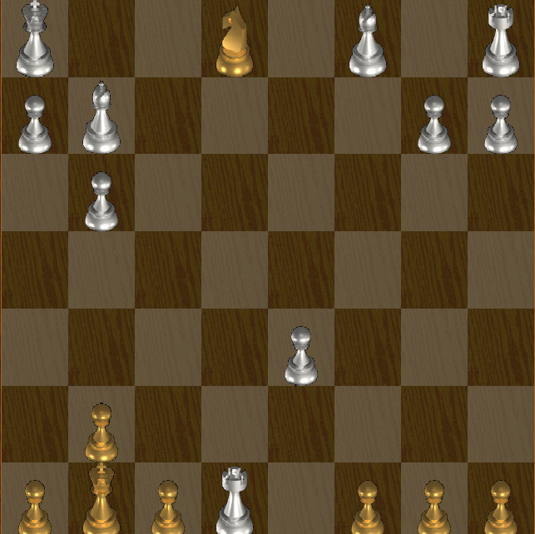
AI Applications
Games:

Slide 60

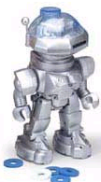
AI Applications
Robotic toys:

Slide 61
AI Applications
Other application areas:
Bioinformatics:
  Gene expression data analysis
  Prediction of protein structure
Text classification, document sorting:
  Web pages, e-mails
  Articles in the news
Video, image classification
Music composition, picture drawing
Natural Language Processing .
Perception.

Slide 62
Homework
Read Pg (1 – 31) From the book

